Slide 1
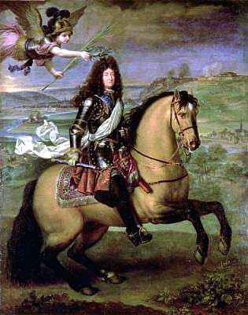
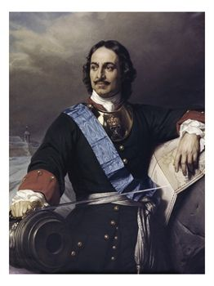
Section 2
THE AGE OF ABSOLUTISM

Slide 2
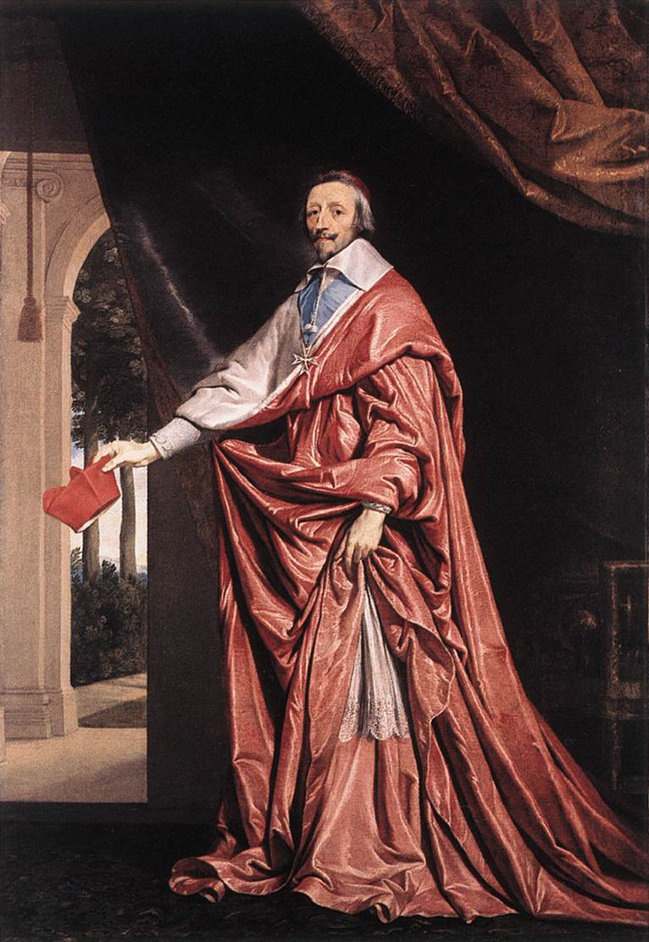
By the late 1600s, FRANCE had replaced Spain as the most powerful European Nation…..
In 1624, France’s King, LOUIS XIII, appointed CARDINAL RICHELIEU as his Chief Minister
Spent 18 years strengthening the central government
Destroyed power of the Nobles
Destroyed Castles and Armies
Replaced Nobles in Royal Government with well-educated professionals
Tied nobles to the King by giving them posts at court
He was the True Power behind the throne

Slide 3
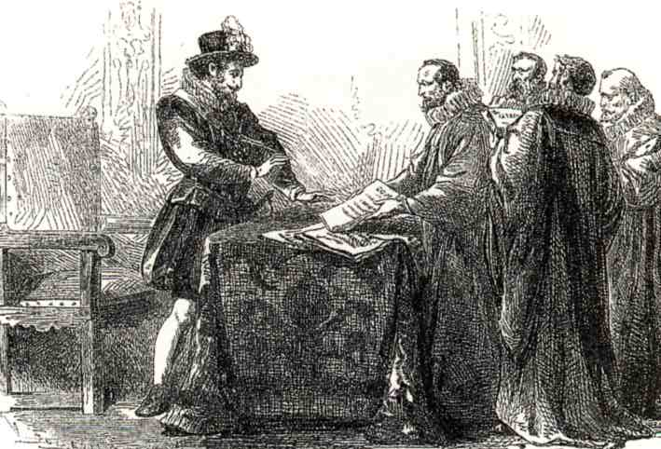
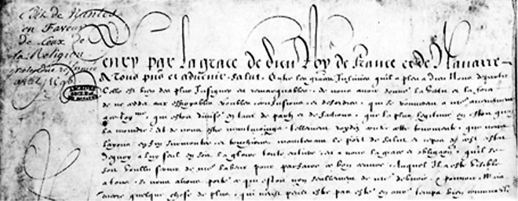
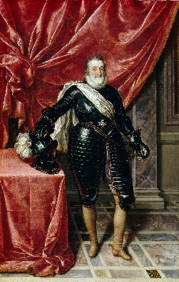
Previously, the 1598 Edict of Nantes had protected the French protestants, the Huguenots from persecution.
Signed by King Henry IV of France. He was trying to stop the horrible religious wars ravaging the county.

Slide 4
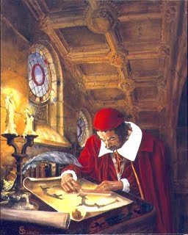
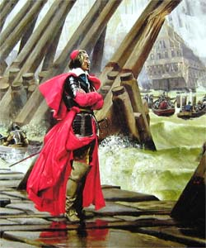
Cardinal Richelieu, who regarded its political and military clauses as a danger to the state, annulled the Edict in 1629.
This gave Richelieu the opportunity he was looking for to destroy the Huguenots’ power and take away their land and money – further strengthening the central government.

Slide 5
LOUIS XIV, the “SUN KING”
“I AM The State.”
Took the sun as symbol of ABSOLUTE POWER
“…as the sun stands at the center of the universe, so the sun king stands at the center of the nation.”
Lived 77 years - 1638-1715
King of France 1643 - 1715 72 YEARS!!!
Longest French Monarchy Ever
1661-took over Government when advisor Mazarin died

Slide 6
LOUIS XIV the “SUN KING”
GOVERNMENT:
Held Absolute Power
NEVER called a meeting of the Estates General
ECONOMY:
Practiced Mercantilism
High Tariffs on Imports
Encouraged Overseas Colonies
WARS:
Massive Army, up to 300,000-strongest in Europe
Wanted to dominate Europe
The Many Foreign Wars drained the Royal Treasury

Slide 7
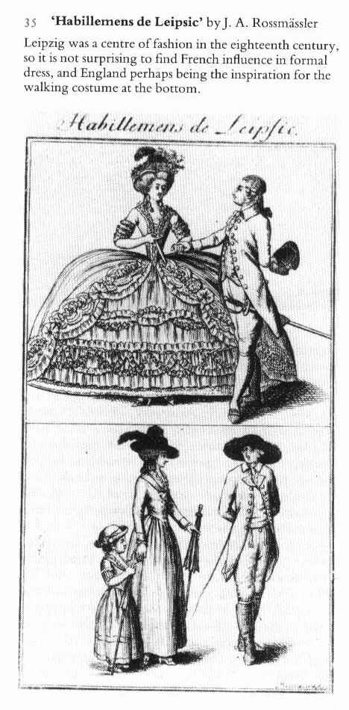
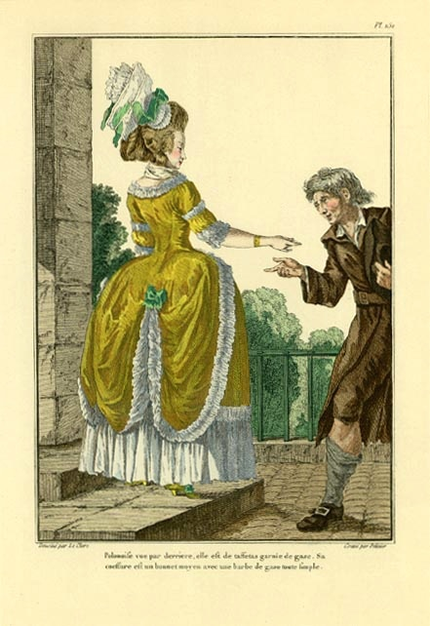
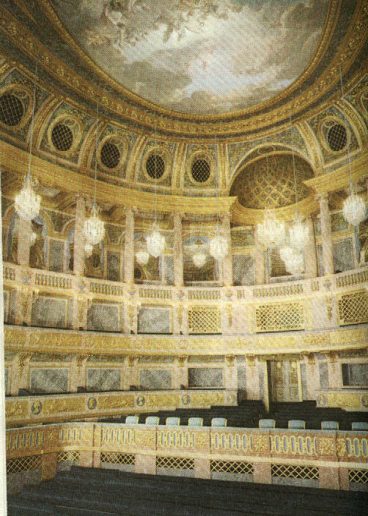
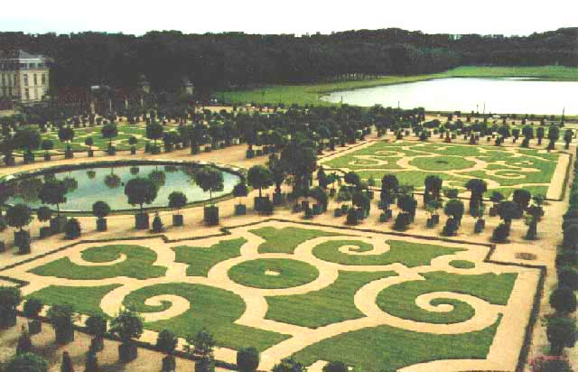
ARTS:
Sponsored musical entertainment and commissioned plays
FRENCH ARTISITIC STYLE became the model FOR ALL EUROPE !!!

Slide 8
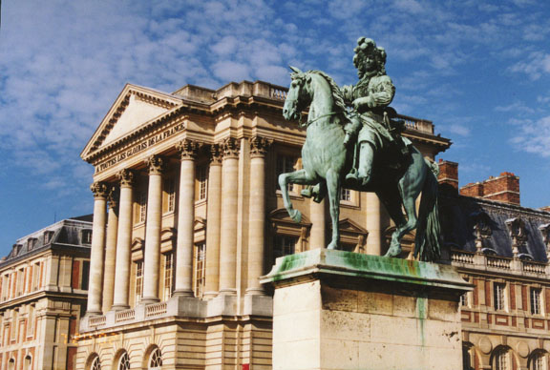
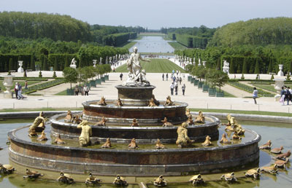
Palace of VERSAILLES Reign of Louis XIV
Immense Palace
Symbol of Wealth and Power
Ceremonies surrounded everyday life

Slide 9
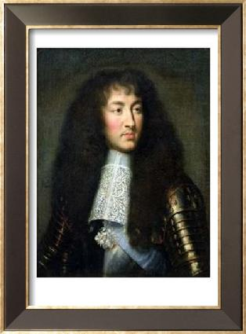
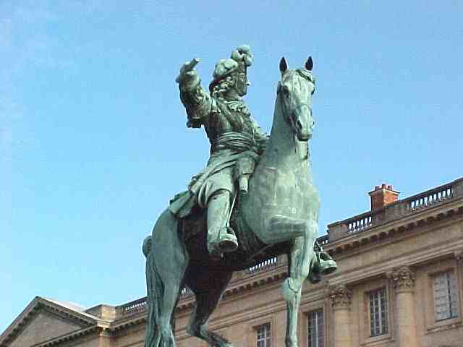
LOUIS XIV the “SUN KING”
Louis XIV Exemplified the Absolute Monarch
France became the most powerful monarchy in all of Europe by the late 1600s

Slide 10
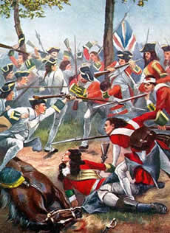
Strong State Declines
Spent too much $ on wars to expand
Dutch & English want Balance of Power
No one nation can dominate politically or militarily
1700 – 1713 – War of the Spanish Succession:
England wanted to prevent the union of France & Spain
That would destroy the balance of power
Treaty of Utrech finally signed – France was never to unite the 2 countries of France and Spain

Slide 11
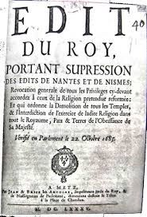
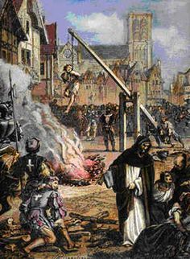
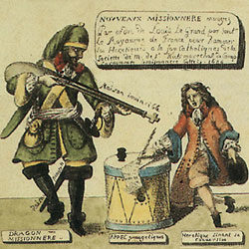
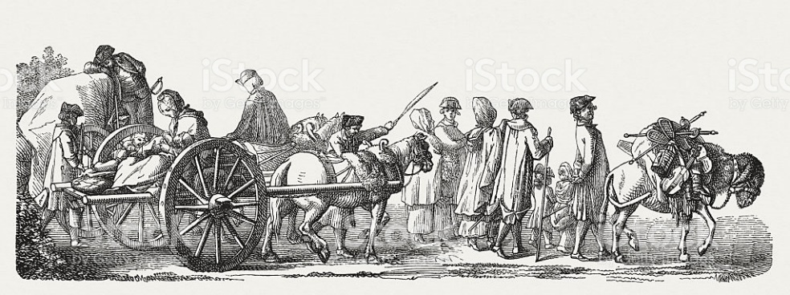
Final blow for the Huguenots -- King Louis XIV later revoked the Treaty of Nantes in 1685 and further deprived the French Protestants of all religious and civil liberties.
They were being killed
Fled France
Took their money and skills with them
Serious blow to the economy
Further led to the decline of the French States’ power

